Slide 1
Adversarial Generation of Continuous Images
March 19, 2022

Slide 2
CONTENTS
2
1. Introduction
03
2. Background
04
- INR
- Fourier Feature
3. Method
10
- FMM
- Multi-scale INR
4. Experiments
13
5. Conclusion
16

Slide 3
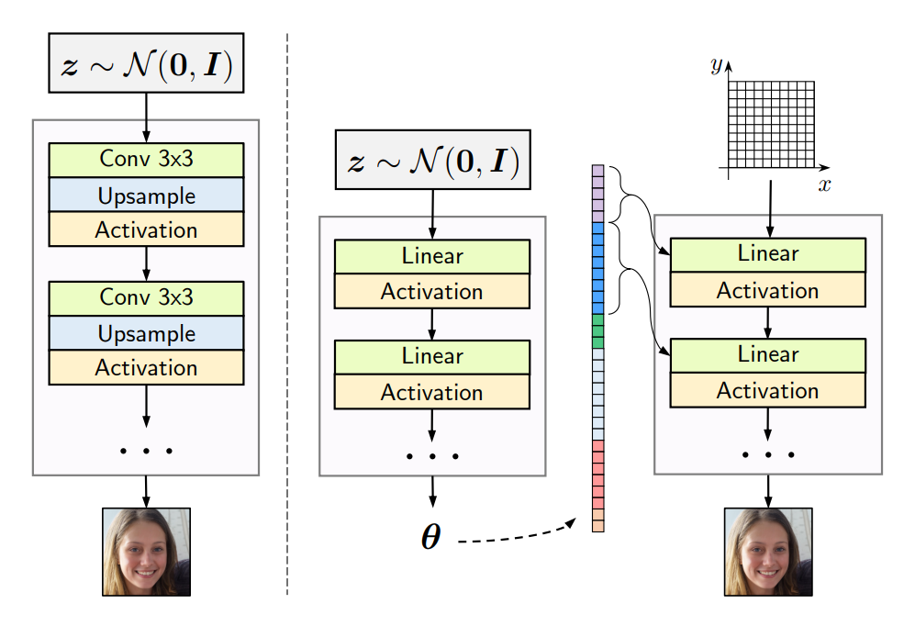
3
Introduction
Continuous image를 생성하기 위해 INR(Implicit Neural Representations)
다양한 이미지 생성을 위해 Hypernetwork 사용
Fourier feature, Factorized Multiplicate Modulation, Multi-scale INR

Slide 4
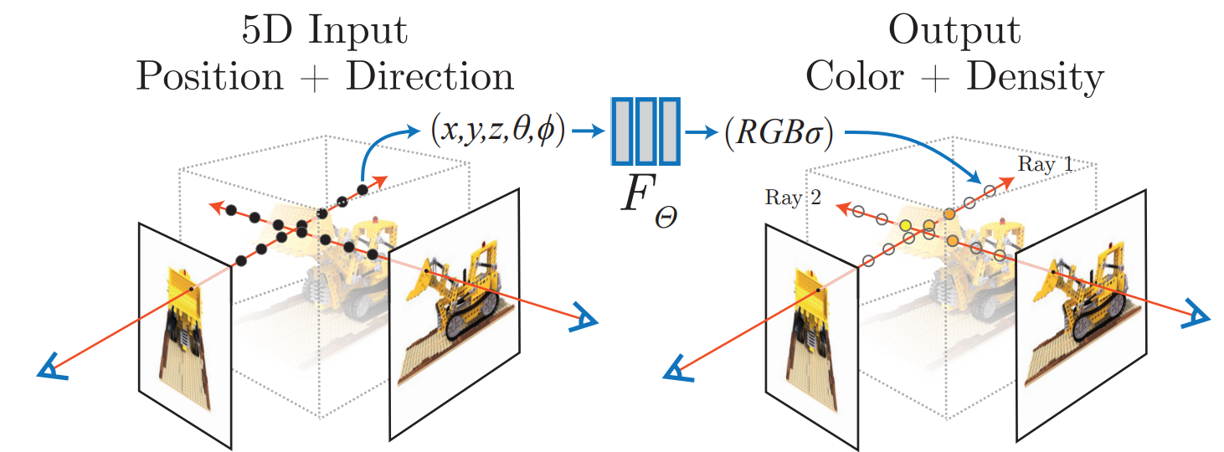
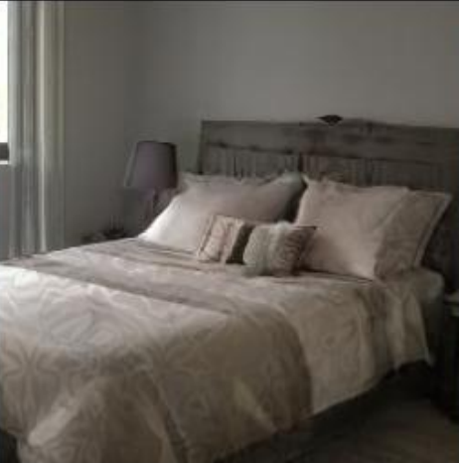
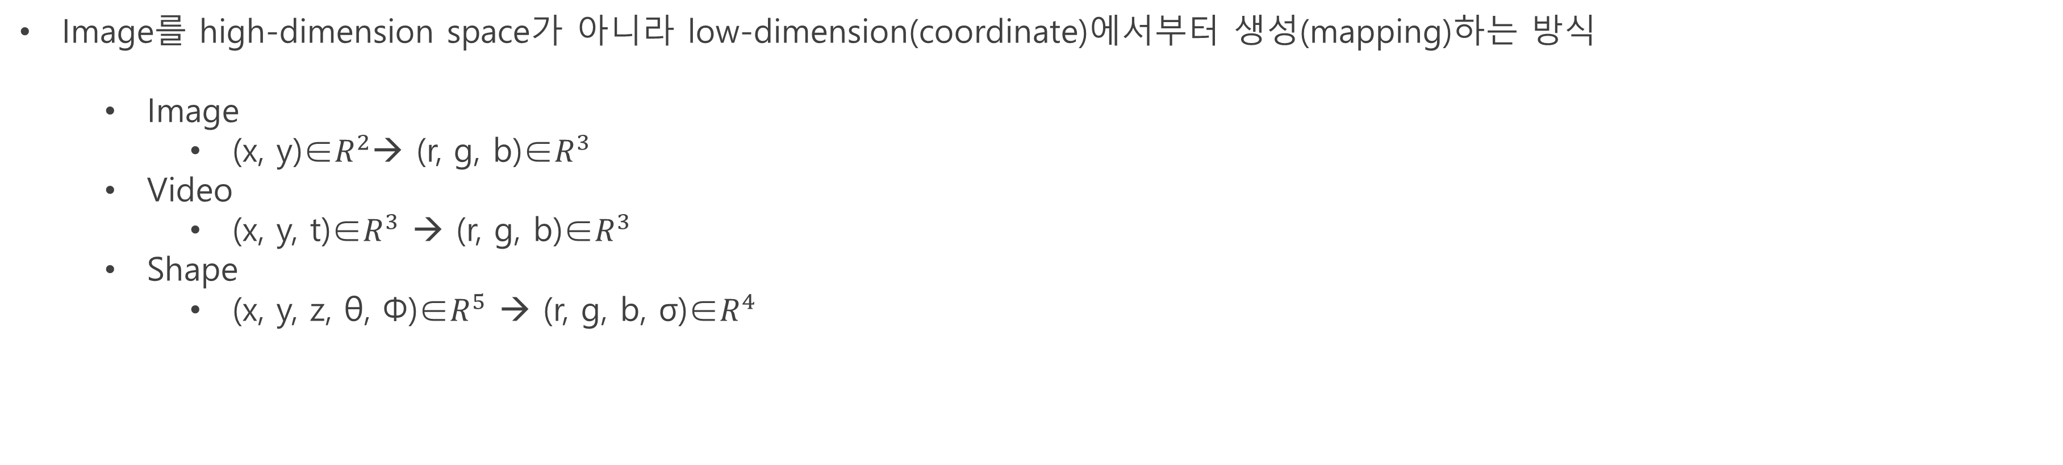
4
Background - INR
Image를 high-dimension space가 아니라 low-dimension(coordinate)에서부터 생성(mapping)하는 방식
Image
(x, y)∈$R^{2}$→ (r, g, b)∈$R^{3}$
Video
(x, y, t)∈$R^{3}$ → (r, g, b)∈$R^{3}$
Shape
(x, y, z, θ, Φ)∈$R^{5}$ → (r, g, b, σ)∈$R^{4}$
NN
(f)
(x, y)
(r, g, b)
[2003.08934] NeRF: Representing Scenes as Neural Radiance Fields for View Synthesis (arxiv.org)

Slide 5
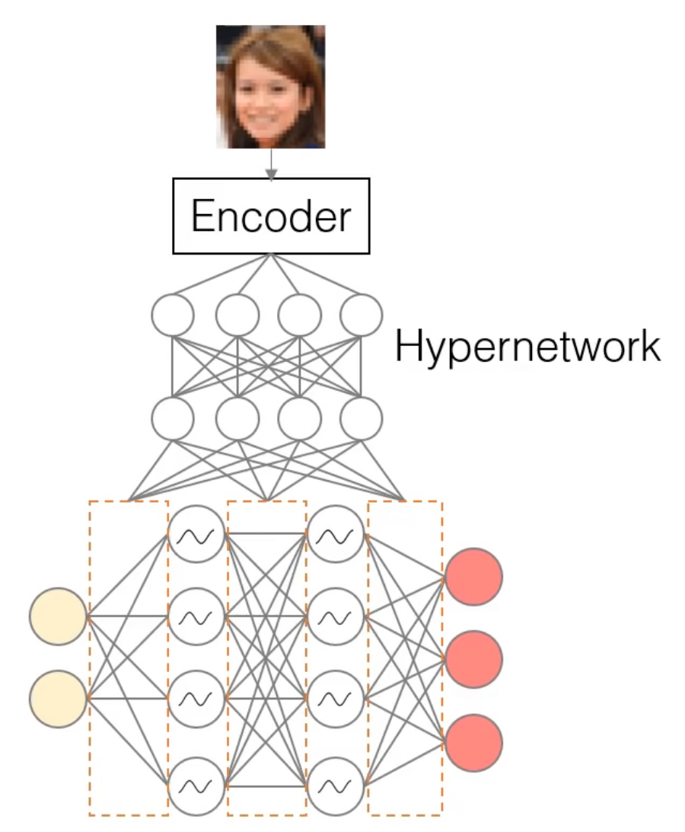
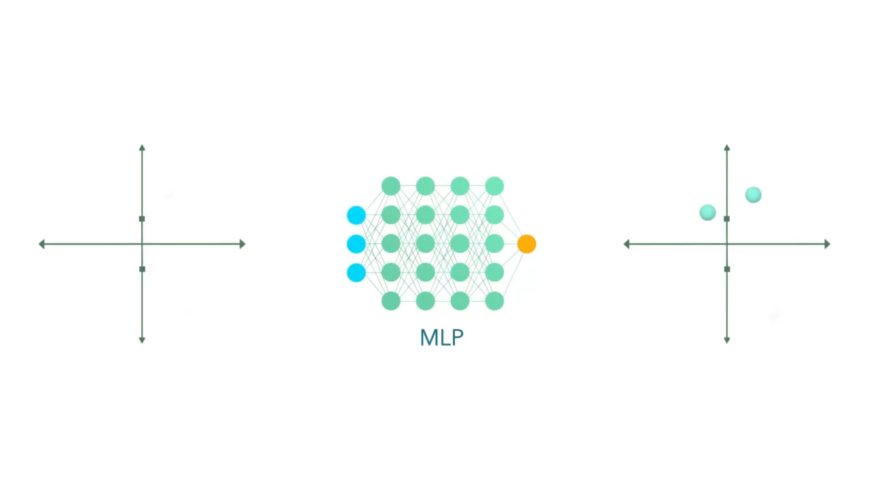
5
Background - INR
Infinite resolution, Super resolution, Zoom
Coordinate 하나당 하나의 pixel에 mapping되기 때문에 Image size에 해당하는 batch로 계산
Receptive field가 없기 때문에 하나의 image에 대해서만 overfitting
여러 이미지를 생성하기 위해 hypernetwork 사용
pixel
Coord
https://www.youtube.com/watch?v=iKyIJ_EtSkw

Slide 6
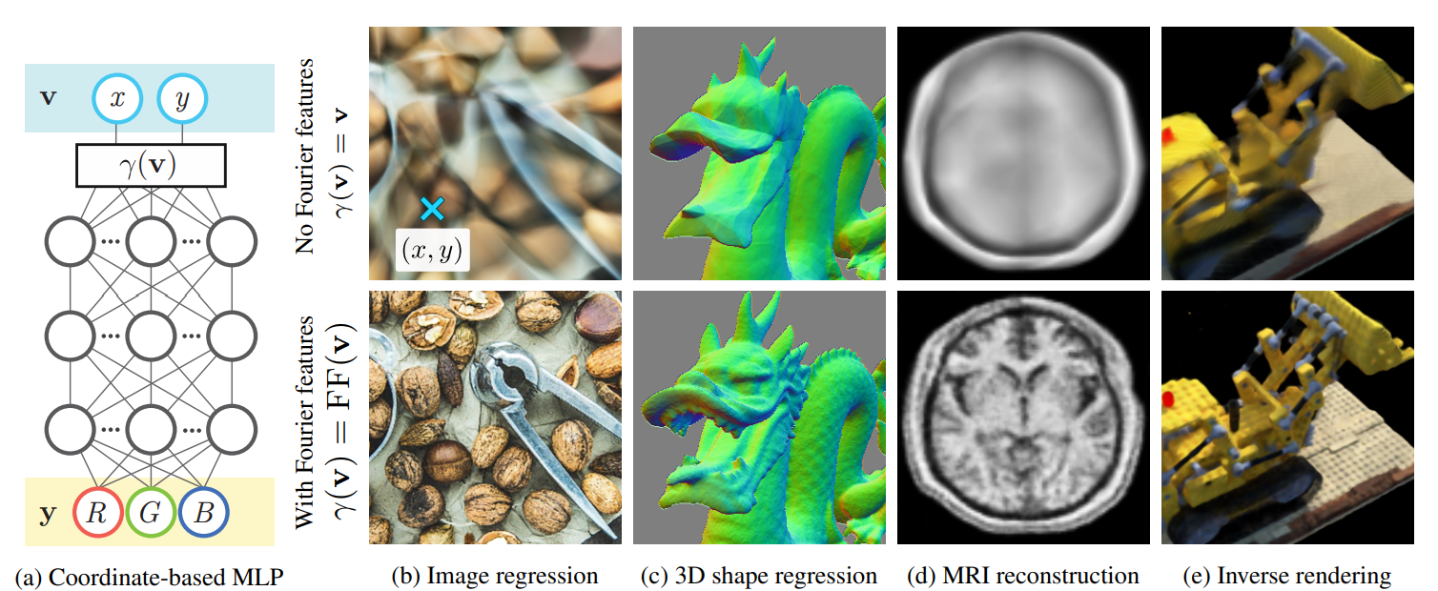
6
Background – Fourier Feature
Coordinate를 Fourier feature로 넣는 방식
Spatial space coordinate의 경우 high frequency에 대해 fitting을 잘 못함
[2006.10739] Fourier Features Let Networks Learn High Frequency Functions in Low Dimensional Domains (arxiv.org)

Slide 7
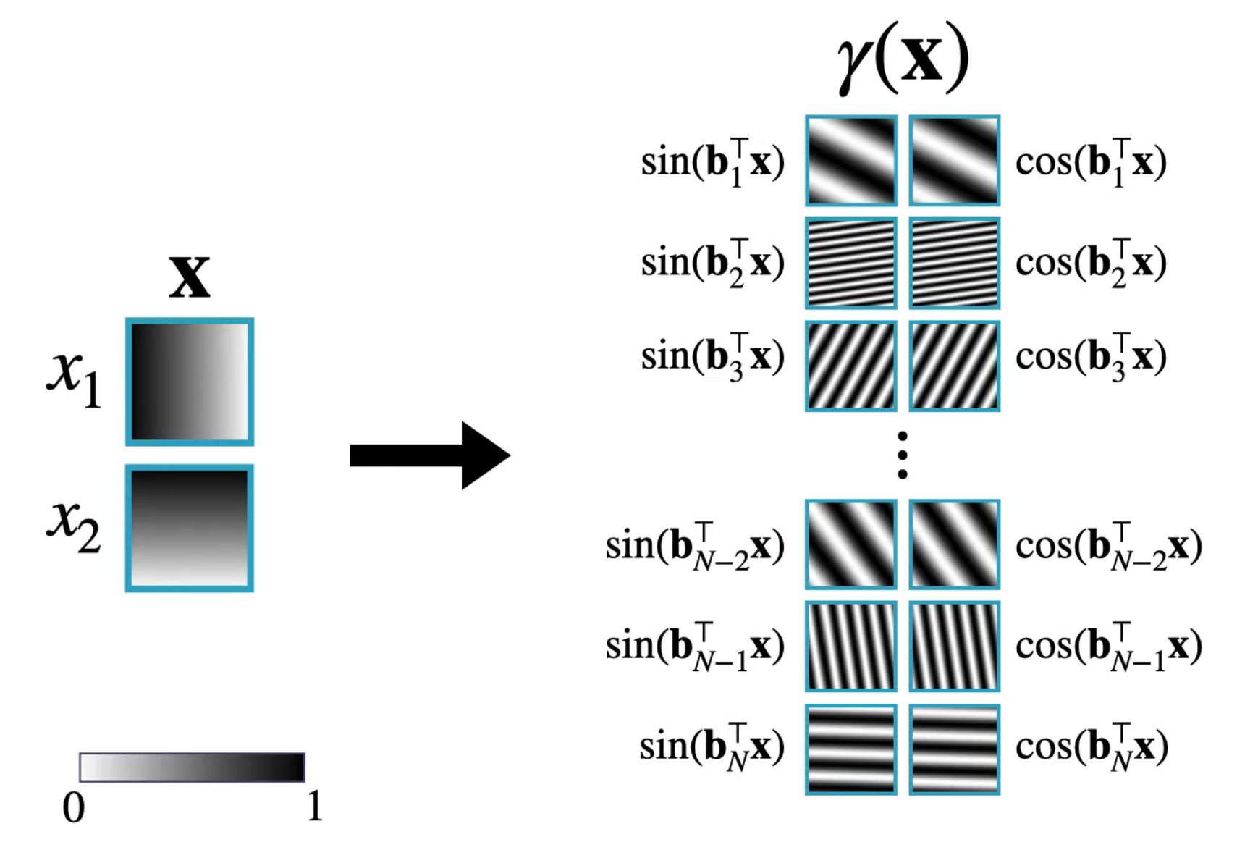
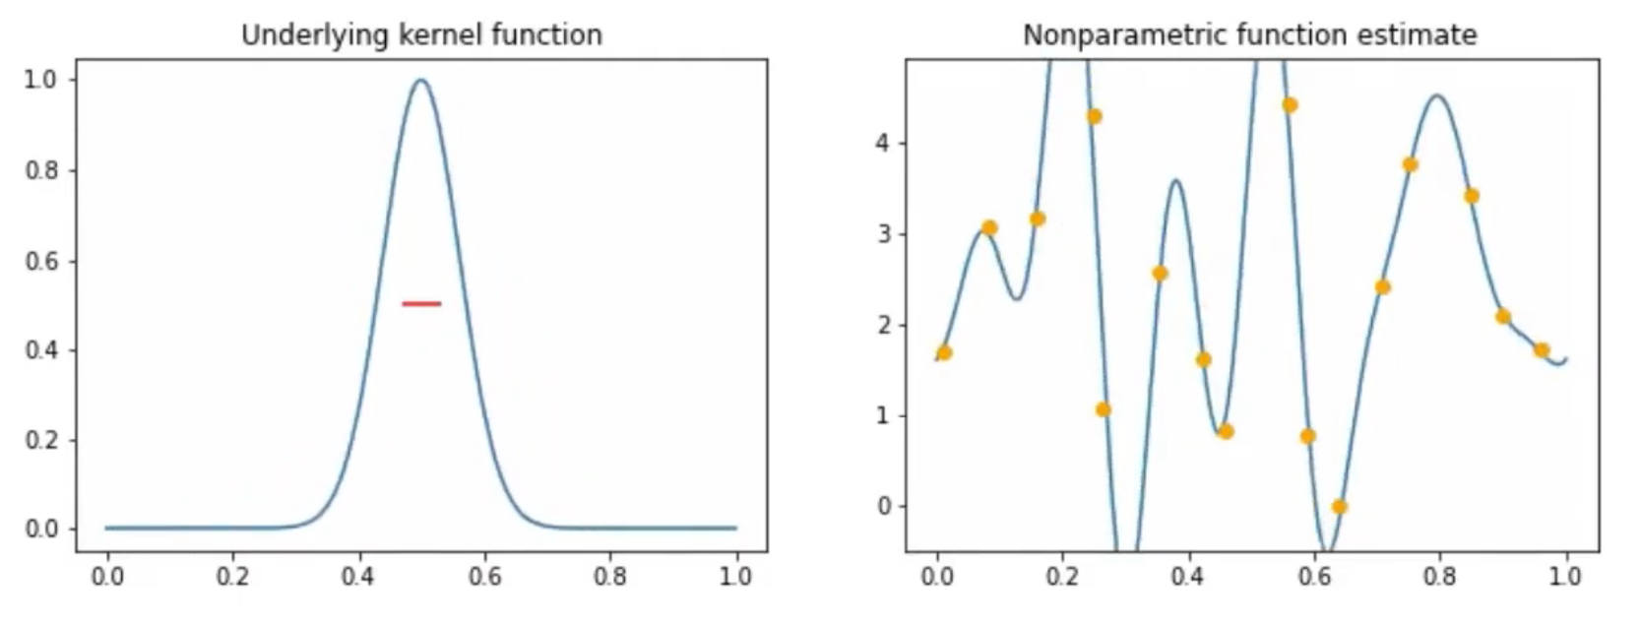
7
Background – Fourier Feature
MLP에서 hidden dimension이 크면 kernel regression으로 간주 가능
[2006.10739] Fourier Features Let Networks Learn High Frequency Functions in Low Dimensional Domains (arxiv.org)

Slide 8
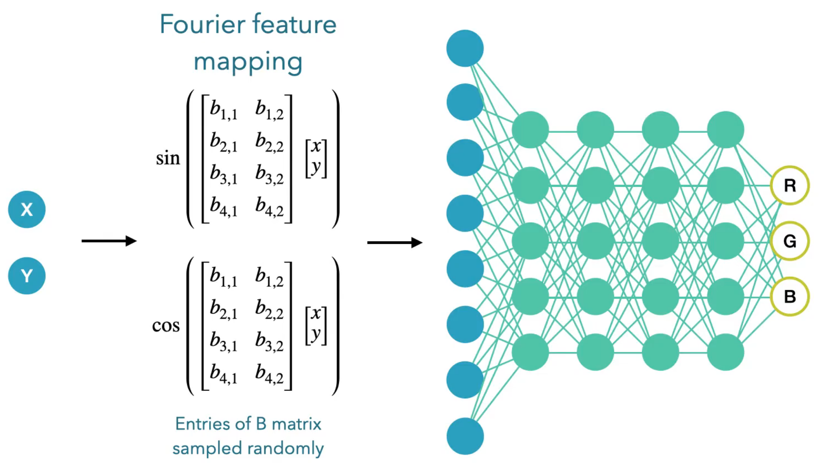
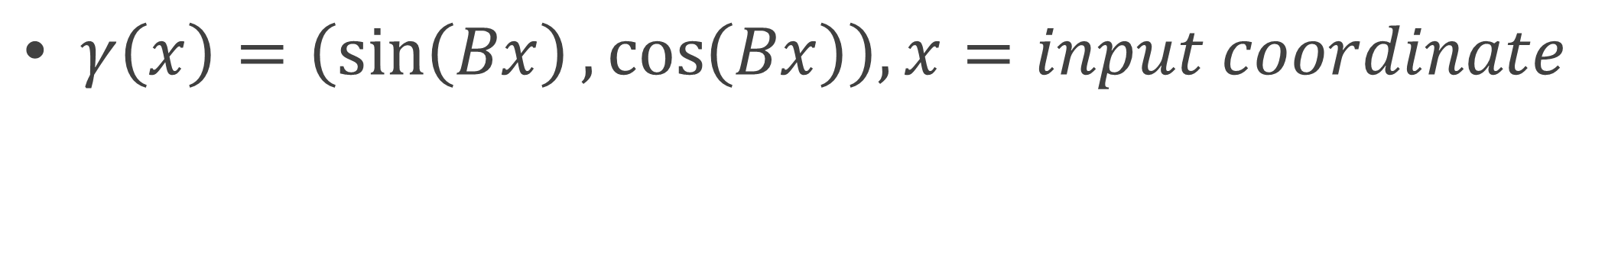
8
Background – Fourier Feature
$γ\left(x\right)=\left(\sin\left(Bx\right), \cos\left(Bx\right)\right), x=input coordinate$
[2006.10739] Fourier Features Let Networks Learn High Frequency Functions in Low Dimensional Domains (arxiv.org)
https://www.youtube.com/watch?v=iKyIJ_EtSkw

Slide 9
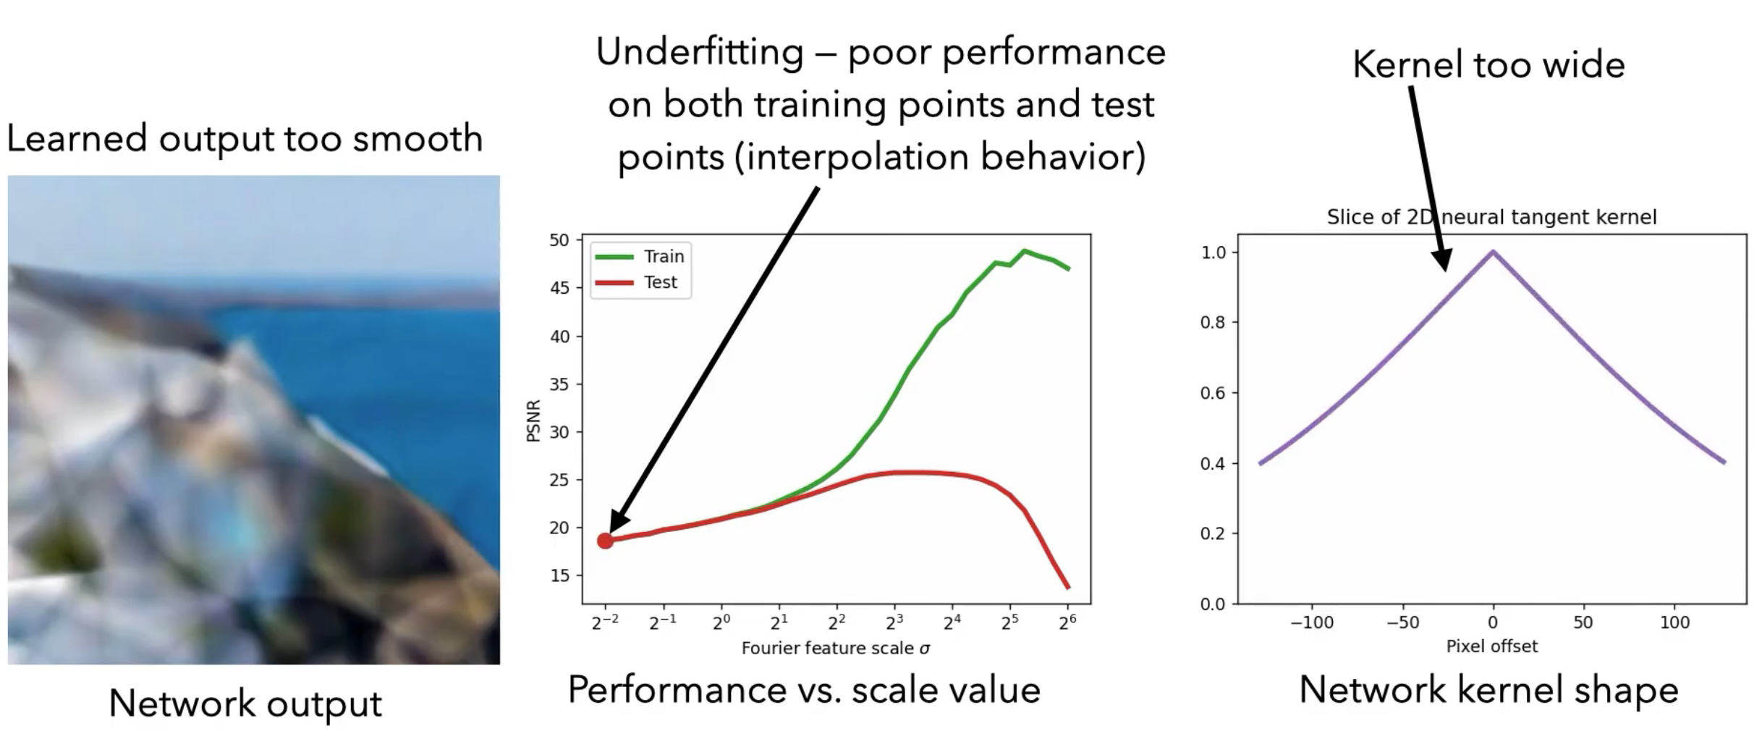
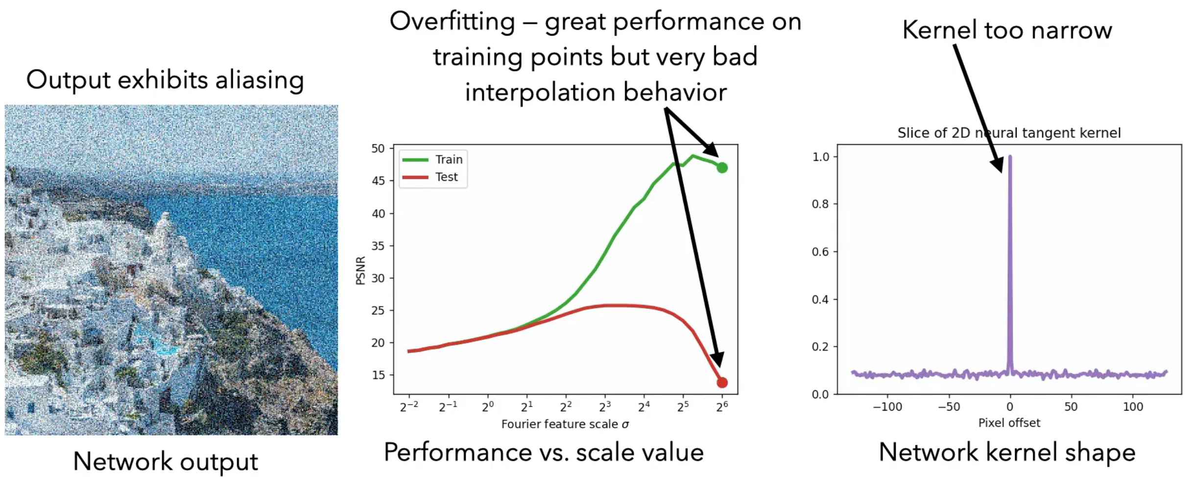
9
Background – Fourier Feature
https://www.youtube.com/watch?v=iKyIJ_EtSkw

Slide 10
10
INR-GAN
Hypernetwork는 훈련이 불안정하고, size(parameter)가 크다.
FMM(Factorized Multiplication Modulation)
Multi-scale INR
Generator
Decoder

Slide 11
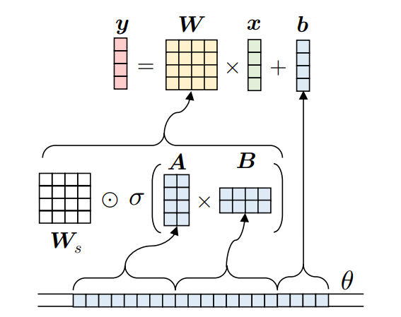
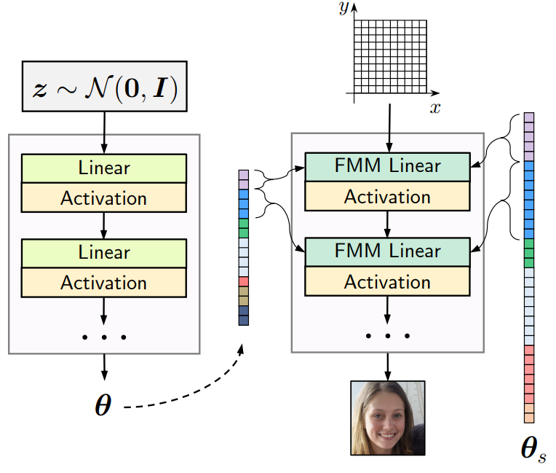

11
FMM (Factorized Multiplication Modulation)
MLP는 CNN에 비해 parameter 수가 많음 → Decomposition
$W^{l}∈R^{n_{in}×n_{out}}$, $b^{l}∈R^{n_{out}}$
Rank가 너무 낮으면 training이 unstable
Full-rank인 $W_{s}$

Slide 12
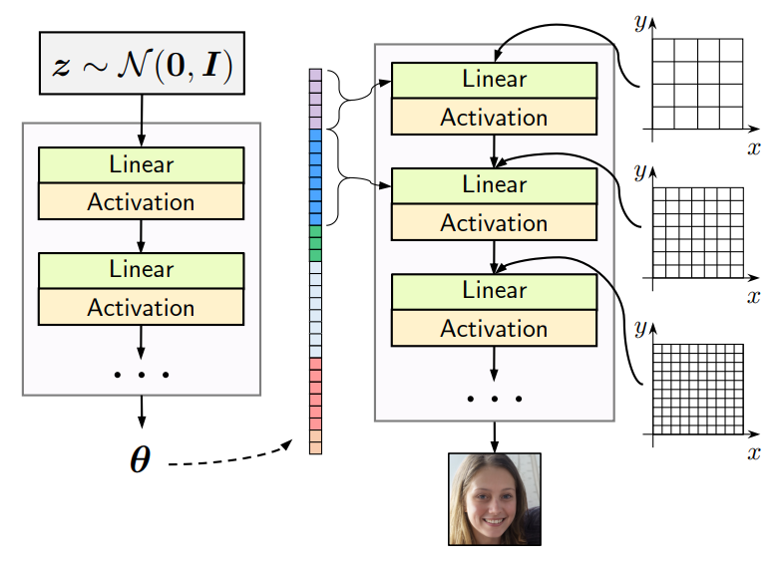
12
Multi-scale INR
기본적인 INR은 큰 resolution에 대해 많은 계산이 필요함
1024의 경우 batch size = 1024 * 1024
각 block에 대해 다른 resolution의 coordinate를 input
각 block이 끝난 후 upsampling
이전 resolution의 값을 condition으로 갖음 (~ receptive)

Slide 13
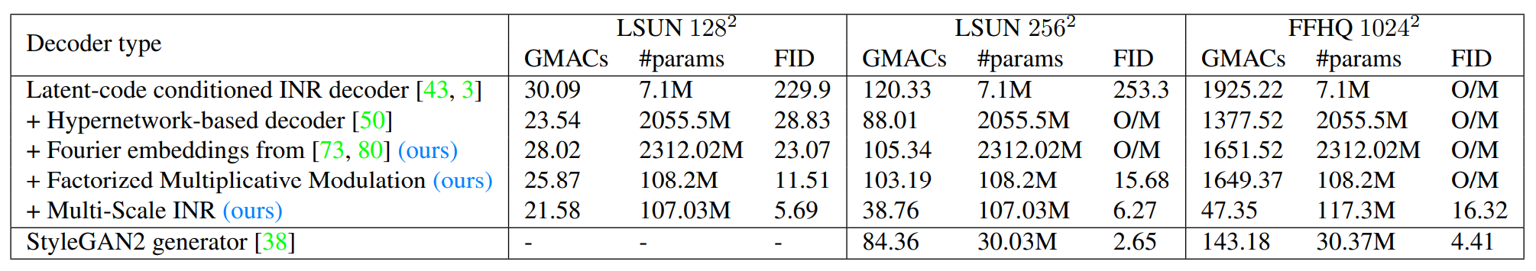
13
Experiments
Resolution
128, 256, 1024
Evaluation metrics
FID, MAC
Model
INR + Hypernetwork + StyleGAN2(Discriminator) + Fourier Feature
Generator

Slide 14
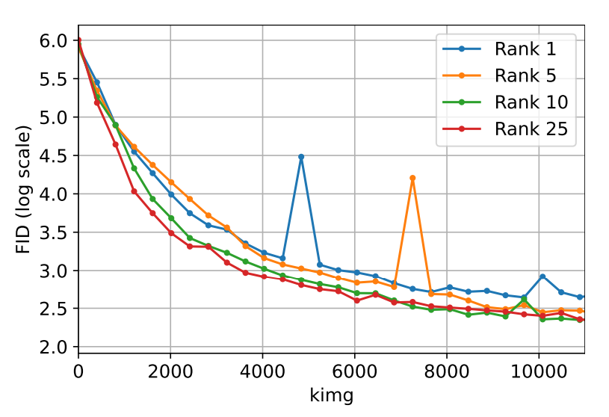
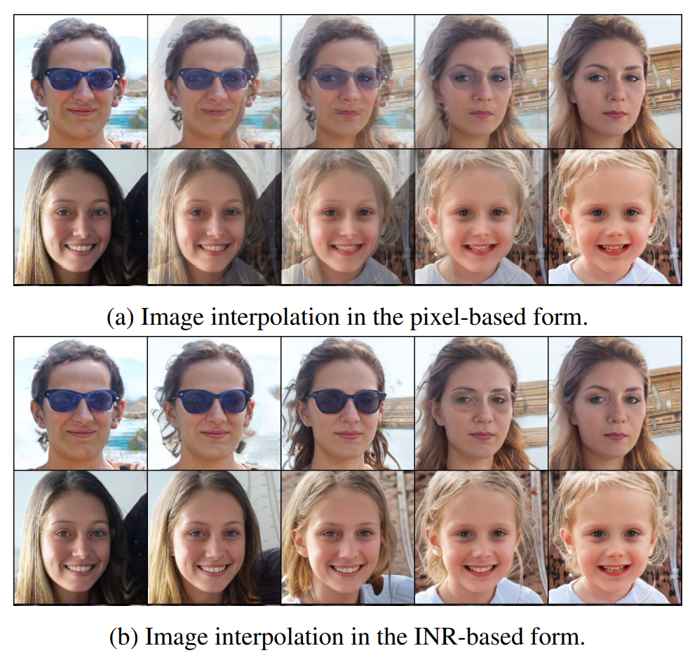
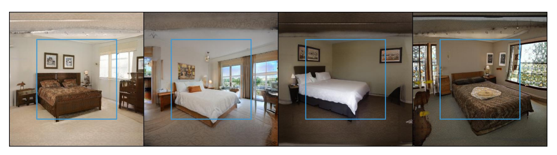
14
Experiments – Rank, Extrapolation, Interpolation

Slide 15
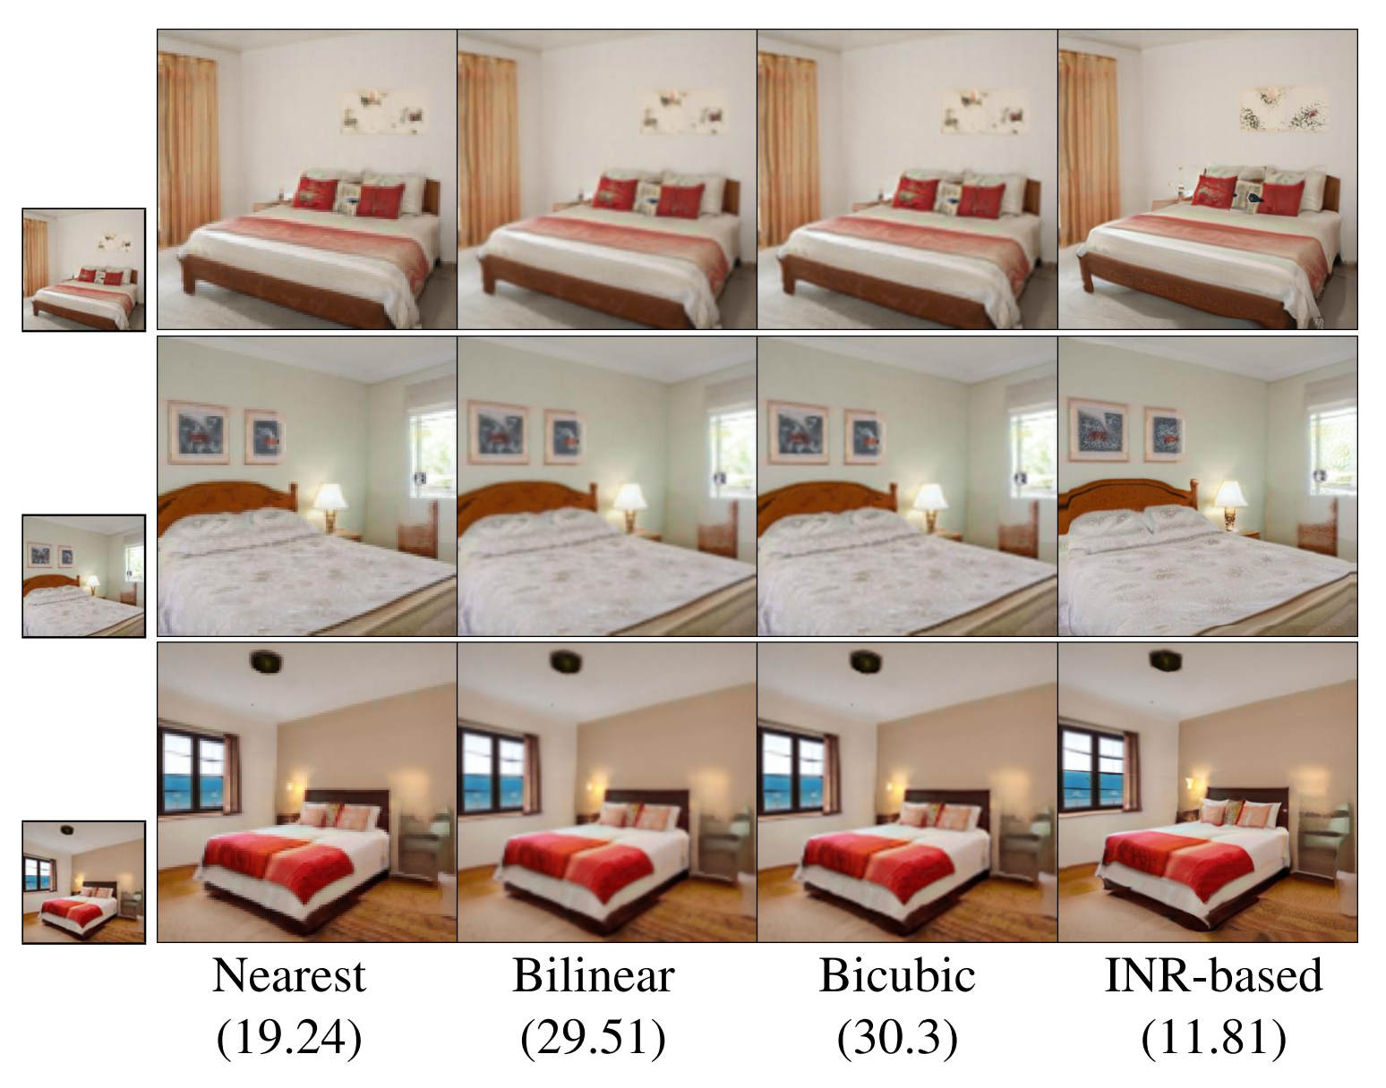
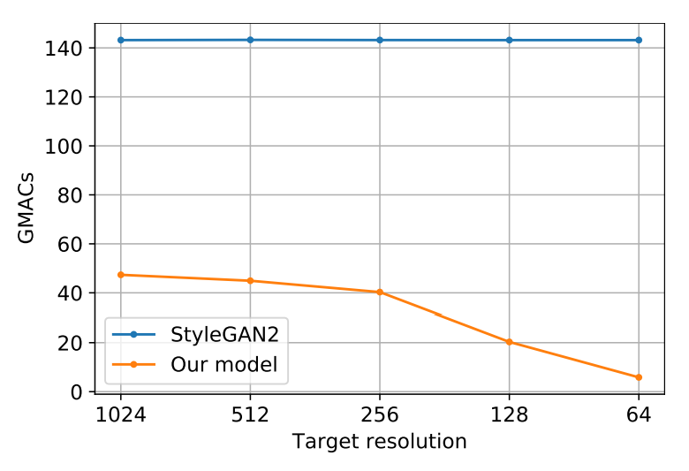
15
Experiments – SR, Low-resolution Inference

Slide 16
16
Conclusion
INR Potential
Faster Inference
Parallel computation
Universal Decoder Architecture
Contribution
High-resolution
Low model size, MACs
Limitation
Spatial information을 사용하지 않음
High-resolution에 너무 민감할 수 있음 – texture artifact
“Adversarial Generation of Continuous Image”

Slide 17
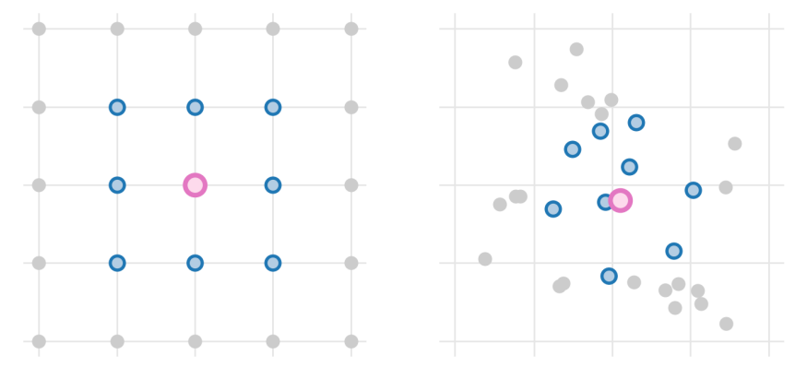
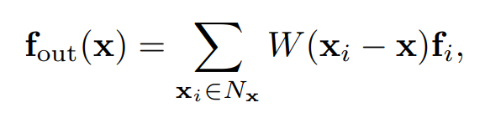
17
Appendix
CIPS_Image Generators with Conditionally-Independent Pixel Synthesis
Generative Models as Distributions of Functions

